Slide 1

Fundamentals of Software Engineering
Sorting Part 2

Slide 2
O(NlogN)
Many of our sorts we covered previously are incredibly slow, so instead we will take the time to look into sorting things differently, using a Divide and Conquer strategy
This typically involves splitting lists into two smaller lists, then sorting those and combining in some way.
These all function similarly to how we did Quicksort when we used it with our array based lists.

Slide 3
Merge Sort
This is a recursive algorithm.
1) Cut the array in half
2) MergeSort the left half of the array
3) MergeSort the right half of the array.
4) return the Merge the two halves of the array into one sorted array

Slide 4
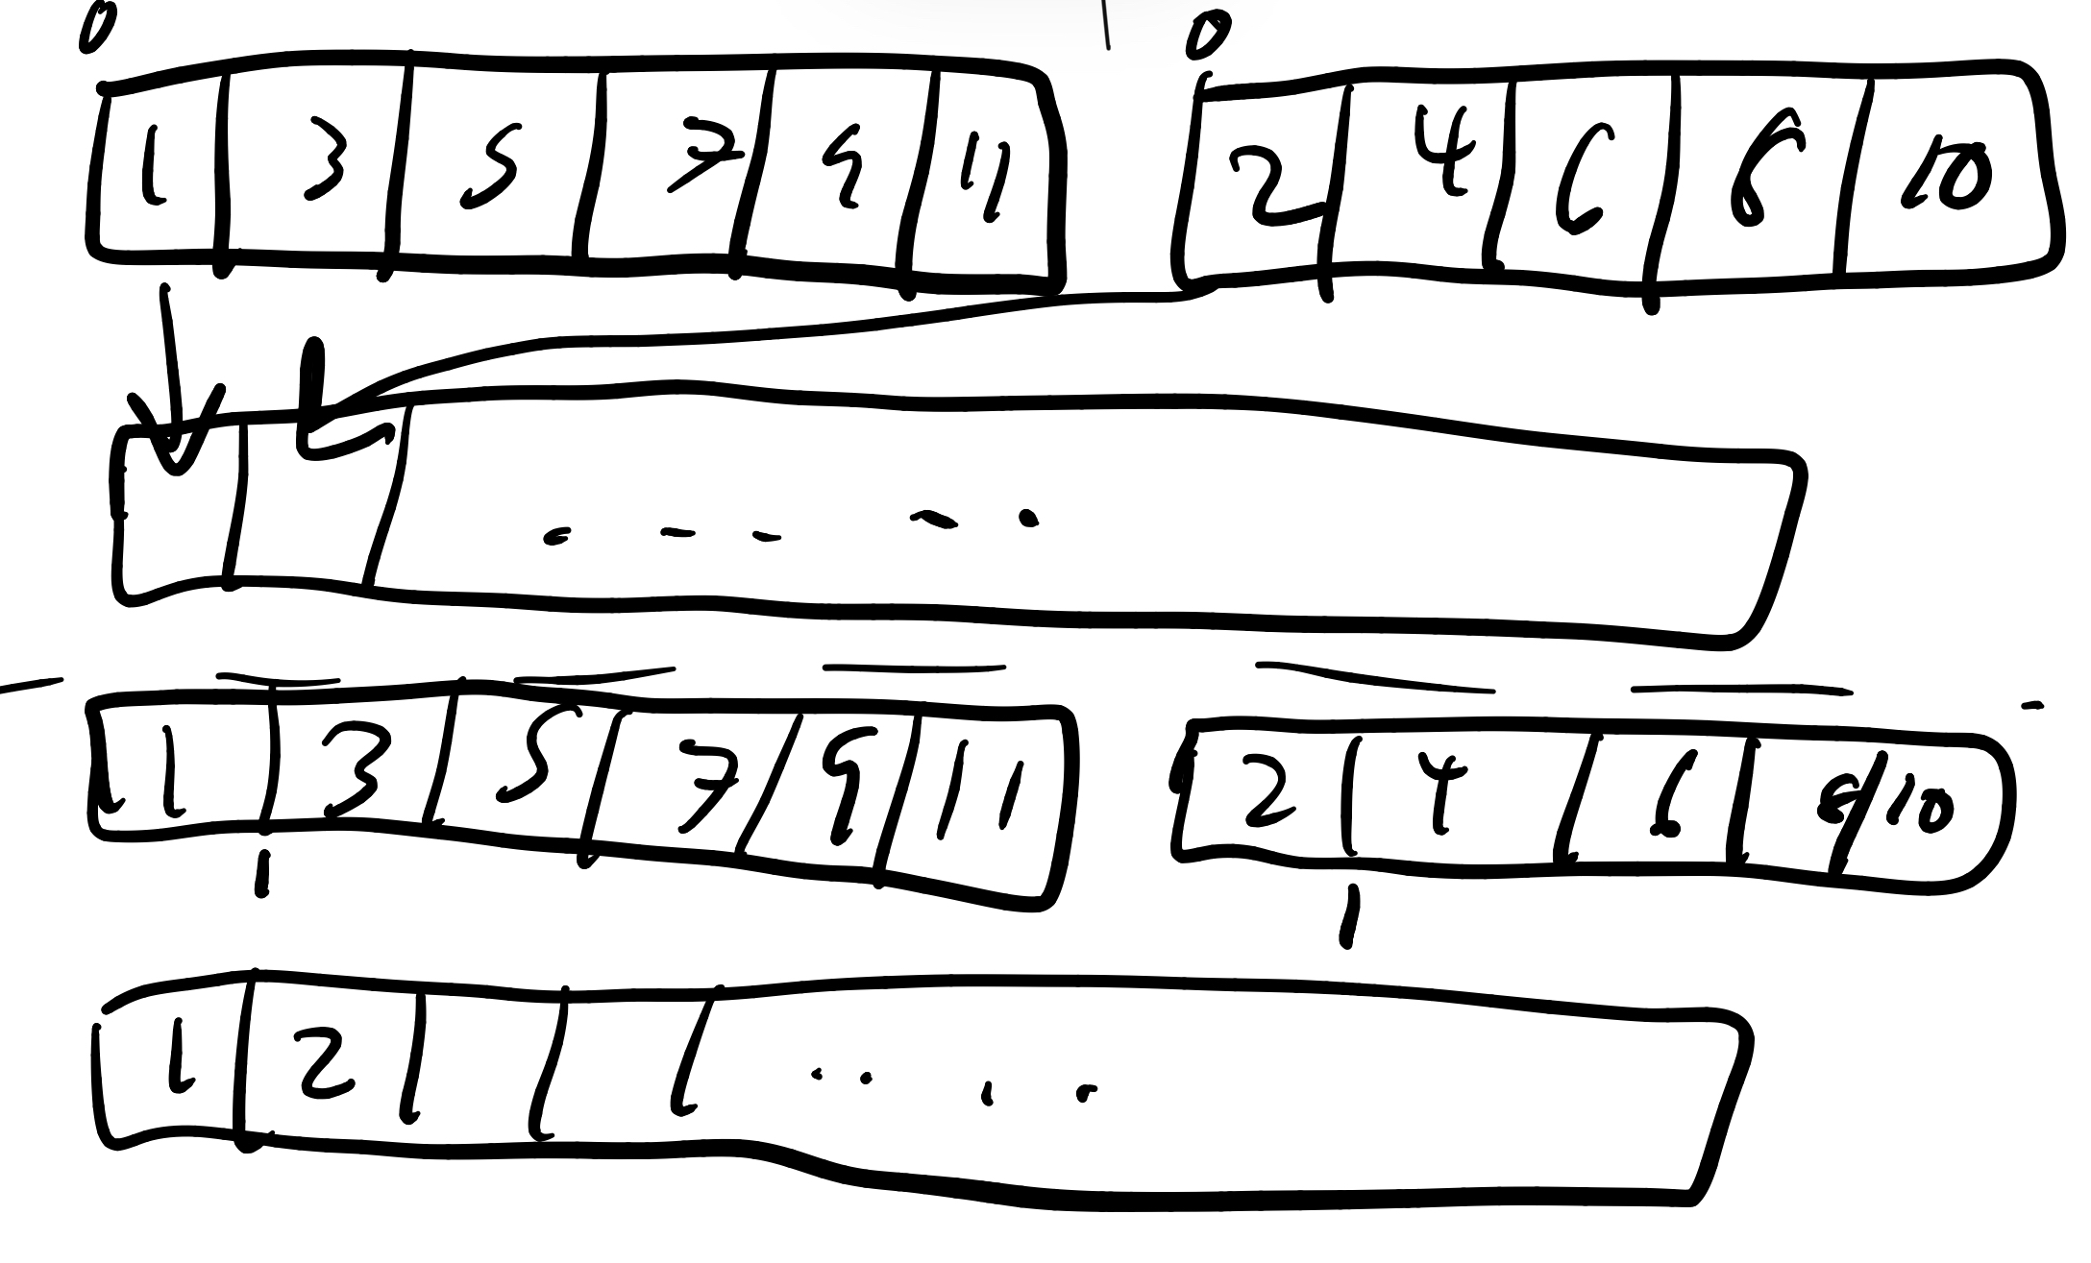
Merge:
1) Count through the left and the right arrays starting at index 0 of each
2) as you count through, put the one that is smaller in the next index of the new sorted array
3) Return this new array

Slide 5
Merge Sort Analysis
A few things to consider with the implementation
1) Value Returning vs inline modification
The value returning implementation is simpler and does not immediately modify your existing array. This is good for testability.
The flip side is modifying the array allows for more efficient code due to no memory allocations.
2) Overall this still maintains n * log(n).
Where does this come from?

Slide 6
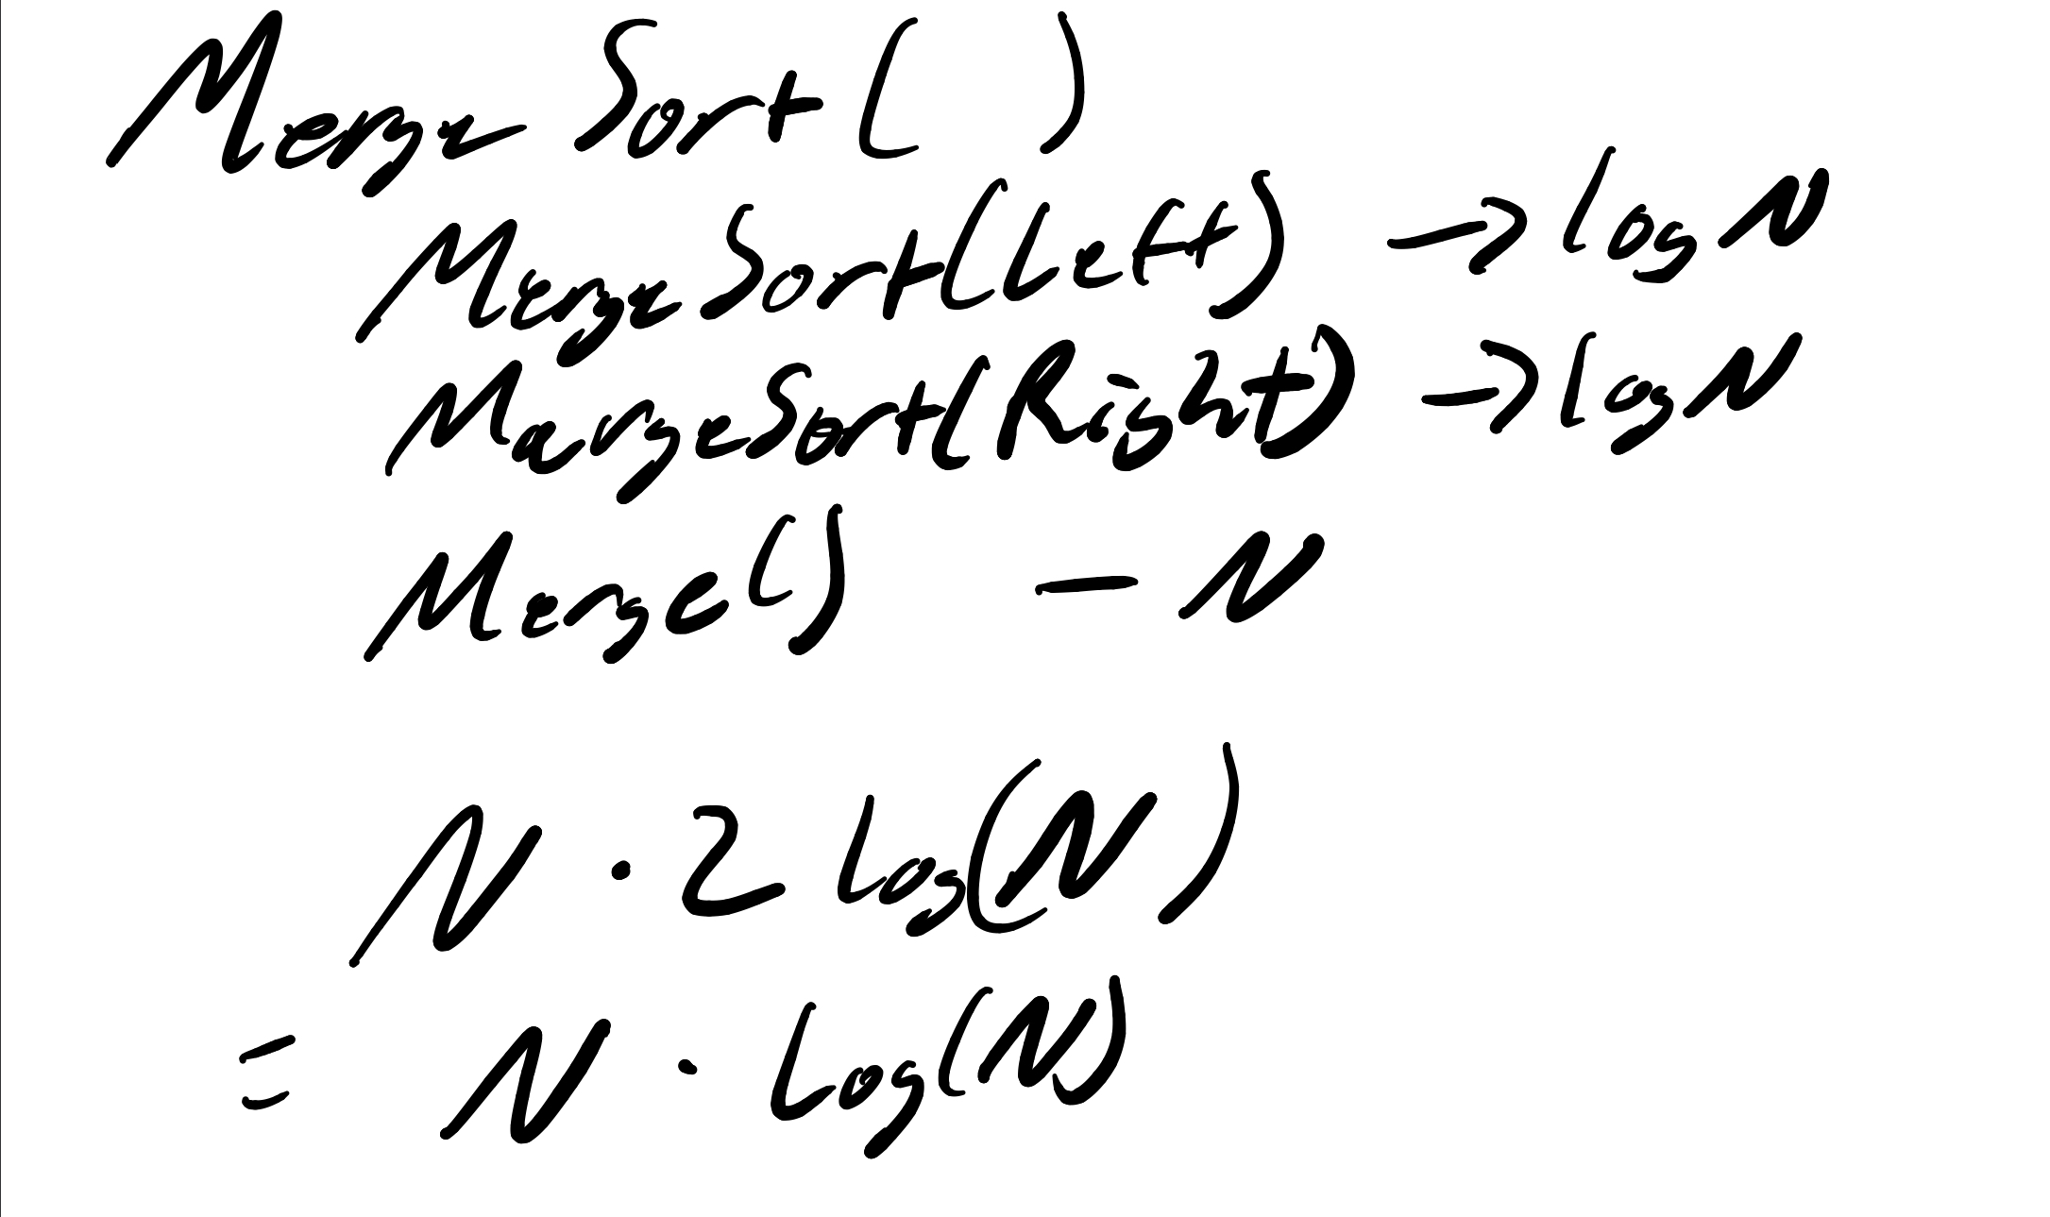
N log(n)

Slide 7
Spatial requirements.
This sort requires auxiliary arrays for each sorting that occurs.
For each split, you need to create a new array and sort into it, which means each split gets a new array.

Slide 8
Quick Sort
Quicksort is another algorithm, but one we have looked at already. This divide and conquer strategy works just as well as merge sort, maintaining N log N complexity.
Each half does N work
And then you do 2 * log N splits (halves).
A thing to note though, quicksort is not always perfect.
If the division is not in the middle, this can quickly escalate to N^2 in speed. The less even the halves are after a split, the worse the efficiency of this algorithm.
Quick Sort does NOT create any extra arrays that must be managed, which will lead to some performance improvements for very large arrays.

Slide 9
Heap Sort
Heap Sort is the final sorting algorithm, and the structure itself is only a log(N) rather than N log N.
This is because only one item is technically in order ever: the “highest priority” item at the top of the heap. The heap maintains perfect log N time, but its never truly in “order”.
However, we can create a sorted array by using a heap structure to create a new array by pushing every element into the heap, then popping them off one at a time and adding them to the back of a list progressively.
Since we do this N number of times, Heap Sort maintains its full O(N * log(N)) complexity.

